Slide 1
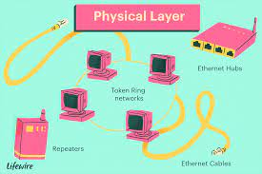
Lec-8
PHYSICAL LAYER:
Signal & Media(Basics for Data Communications and Analog and Digital signals).

Slide 2
What is Physical layer ?
The physical layer is also called the lowest layer and it is organized in the first position of the Open Systems Interconnection (OSI) communications model.
The responsibility of physical layer is to controls the way unstructured, raw, bit -stream data is sent and received over a physical medium.
This layer is also responsible for electrical signaling, cabling and sending bits from one computer to another.
It also handles the transmission rate to improve the flow of data between a sender and receiver.

Slide 3
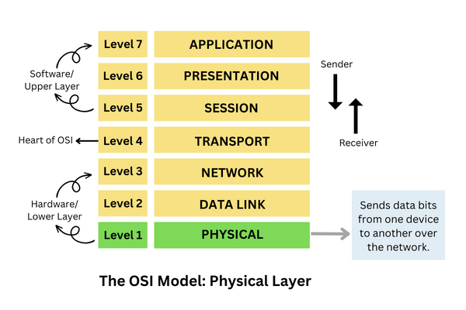
Examples of Physical layer.
Some of the examples of physical layer is Repeaters, hubs, network interface cards (NICs), cables, and connectors are important examples of physical layer.
Repeaters are used to regenerate electrical signals that have been weakened due to distance.
A hub is a networking device which works on physical layer which is used to connect multiple devices on the network.

Slide 4
Function of Layer 1- Physical Layer

Slide 5
Functions which are performing by physical layer.
Type of transmission media
Representation of bits
Data rate
Synchronization of bits
Line Configuration
Topology
Transmission mode

Slide 6
What is Transmission media?
Transmission media is a type of communication channel that carries the information from the sender end to the receiver end. Data is transmitted through the electromagnetic signals.
The main functionality of the transmission media is to take the information or data in the form of bits through LAN.
In OSI(Open System Interconnection) phase, transmission media supports the physical layer which is the first layer of OSI model.
In the transmission media the data transmission is determined by the characteristics of medium and signal.

Slide 7
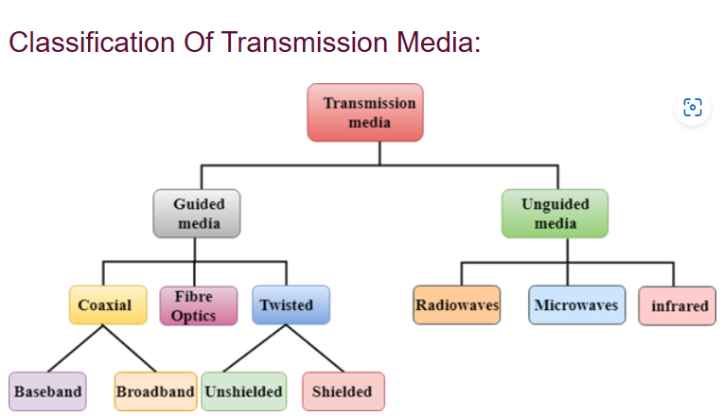
Transmission Media Types.

Slide 8
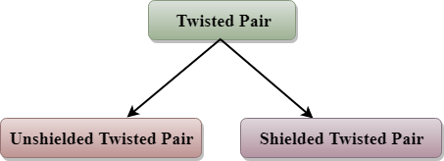
What is Guided Media and Unguided Media?
Guided Media is defined as the physical medium through which the signals are transmitted. It is also known as Bounded media.
Types Of Guided media
Twisted pair – Twisted pair is a physical media made up of a pair of cables twisted with each other and it -consists of two insulated copper wires arranged in a regular spiral pattern. Types of Twisted Pairs.

Slide 9
Unshielded Twisted Pair.
An unshielded twisted pair is widely used in telecommunication.
Category 1: Category 1 is used for telephone lines that have low-speed data.
Category 2: It can support upto 4Mbps.
Category 3: It can support upto 16Mbps.
Category 4: It can support upto 20Mbps. Therefore, it can be used for long-distance communication.
Category 5: It can support upto 200Mbps.

Slide 10
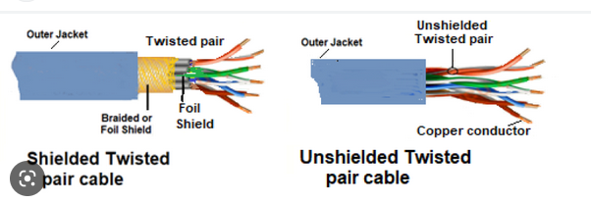
Shielded Twisted Pair .
A shielded twisted pair is a type of cable that contains the mesh surrounding the wire that allows the higher transmission rate.

Slide 11
What is coaxial cable ?
A coaxial cable is define as the type of shielded and insulated copper cable which is used in computer networks and provide the cable TV services to end users.
It was firstly designed in the early 1940s and is used for both baseband and broadband data communication services.
Types of coaxial cable.
What is baseband and broadband coaxial cable?
A baseband is a type of coaxial cable which transmits a single signal at a time at very high speed.
A broadband is a type of coaxial cable can transmit many simultaneous signals using different frequencies.

Slide 12
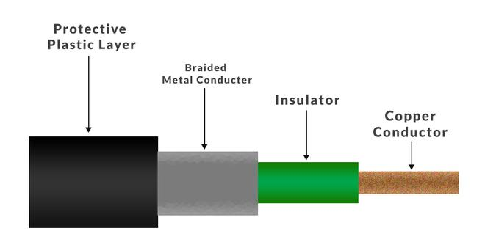
Structure of coaxial cable .

Slide 13
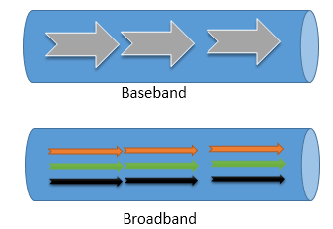
Main Difference between the baseband and broadband coaxial cable .
The main difference between both cables baseband uses digital signaling whereas broadband uses analog signals in the form of optical or electromagnetic waves over multiple transmission frequencies.

Slide 14
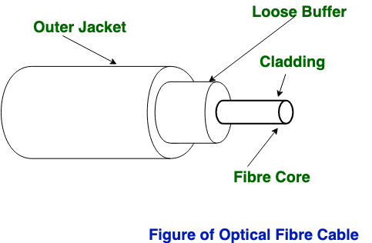
What is Fiber Optics ?
Fiber Optics is made up of a thin flexible fibers of glass or other transparent solids to transmit light signals which is used in telecommunications .
Fiber-optic cables is used for transmit data via fast-traveling pulses of light.

Slide 15
How Transmission is performed in Fiber optics .
In the fiber optic cable the information is transmitted by propagation of optical signals (light) through fiber optic cables and not through the electrical/electromagnetic signals. Because of this, the fiber optics communication supports longer distances as there is no electrical interference.
The fiber optic cables are made of very thin strands of glass (silica). It supports high data rates.
It is used for accessing the internet from home through FTTH (Fiber-To-The-Home) lines.
Examples − OC-48, OC-192, FTTC, HFC.

Slide 16
What is Unguided Media ?
Unguided media is a type of wireless communication which provides flexible communication by uses signals such as radio waves, microwaves, infrared and satellite communication.

Slide 17
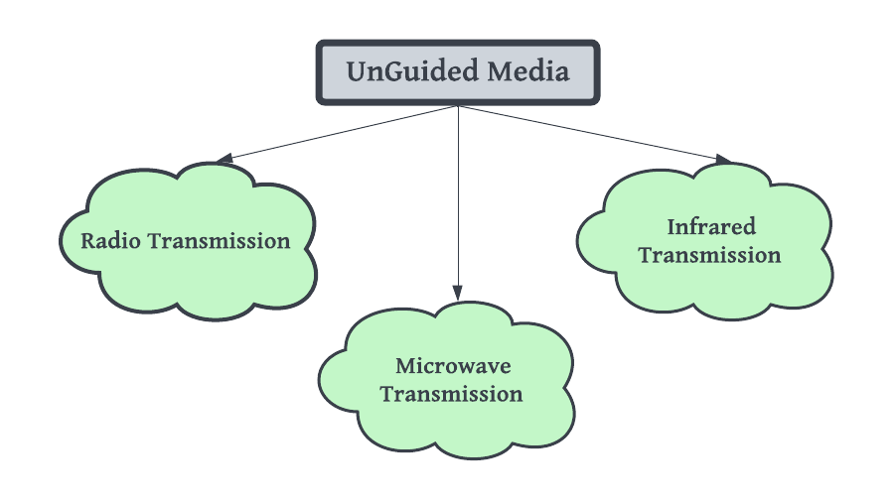
Types of Unguided Media ?

Slide 18
What is Microwave transmission ?
Microwave transmission- It comprises of an electromagnetic wave having a range of frequencies approximately (1-300GHz).
Microwaves travel in straight lines and therefore the narrow focus concentrates all the energy into a beam.
In microwaves periodic repeaters are necessary for long distances and for transmitting and receiving antennas are aligned accurately.
Example − Bluetooth technology.

Slide 19
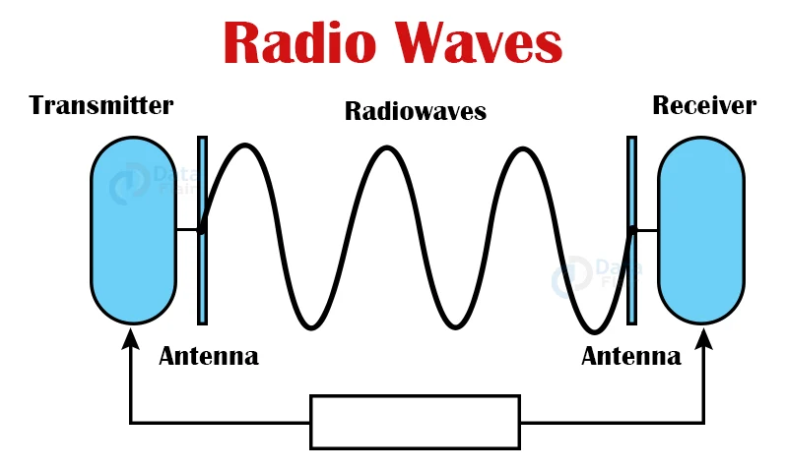
What is Radio Transmission ?
The radio waves are the low-frequency electromagnetic wave ranging from ‘3 kHz to 1GHz’. As the radio waves are having the low-frequency waves, they can penetrate walls and you can receive signals even if you are inside the building. The radio waves are also called a omnidirectional which means that the source transmitter transmits the radio wave in the sky and they are reflected from the sky and received by the receiving antenna.

Slide 20
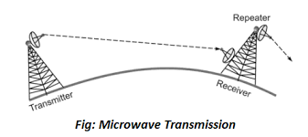
Microwave Transmission.
The microwave is the electromagnetic waves with frequency ranging from ‘1 to 300 GHz’. The microwaves are unidirectional in nature and due to which it propagates in line-of-sight mode.

Slide 21
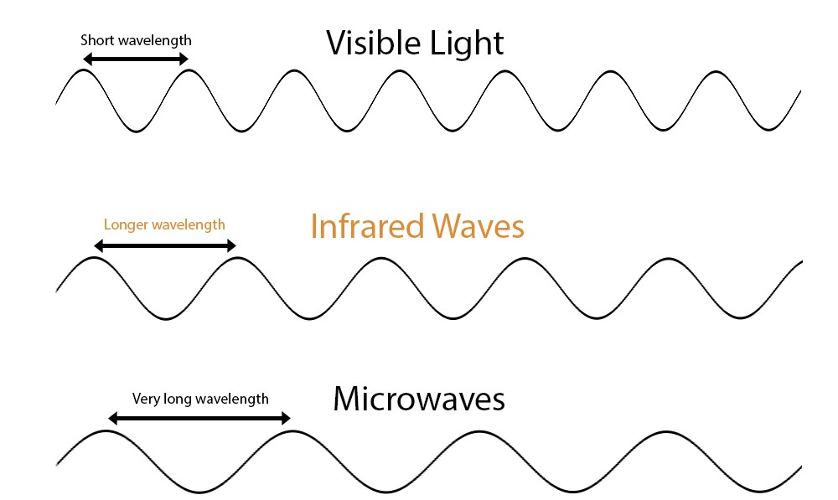
What is infrared Transmission ?
Infrared is used in wireless technology devices or systems that convey data through infrared radiation.
Infrared wireless is used for medium and short range communications and control.
Infrared technology is used in instruction detectors; robot control system, medium range line of sight laser communication, cordless microphone, headsets, modems, and other peripheral devices.

Slide 22
What is difference between Analog and digital signals .
Analog and digital signals are the types of signals which are used for carrying information.
Signal is defined as Information converted into an electrical form suitable for transmission is called a signal
The major difference between both types of signals -
Analog signals- The analog signal is a continuous signal in which information is encoded as the continuous variable and in analog signals have using the continuous electrical signals.
Digital signals – The digital signal is also type of signal which are not continuous, but signals are discrete in value and time. These signals are represented by binary numbers and consist of different voltage values. Digital signals have non-continuous electrical signals.

Slide 23
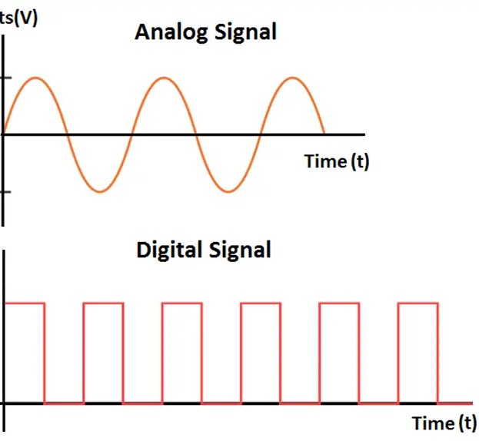
Diagram of Analog and Digital signals.

Slide 24
What is Basic of DATA COMMUNICATIONS ?
The term telecommunication means communication at a distance. The word data refers to information presented in whatever form is agreed upon by the parties creating and using the data.
The basic of data communications is based on the transmission of this digital data between two or more computers and a computer network or data network is a telecommunications network that allows computers to exchange data.
Data communications are the exchange of data between two devices via some form of transmission medium such as a wire cable or may be wireless.

Slide 25
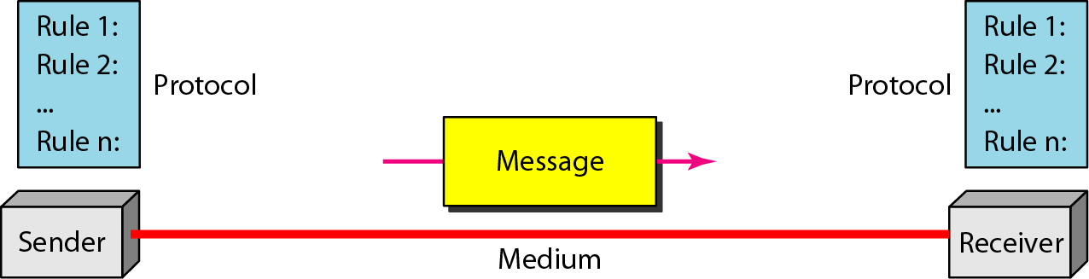
Components of a Data Communication System .

Slide 26
Different basic components of data communication .
Five Components:
Message- Text, Number, Image, Audio, Video
Sender
Receiver
Transmission Medium
Protocol

Slide 27
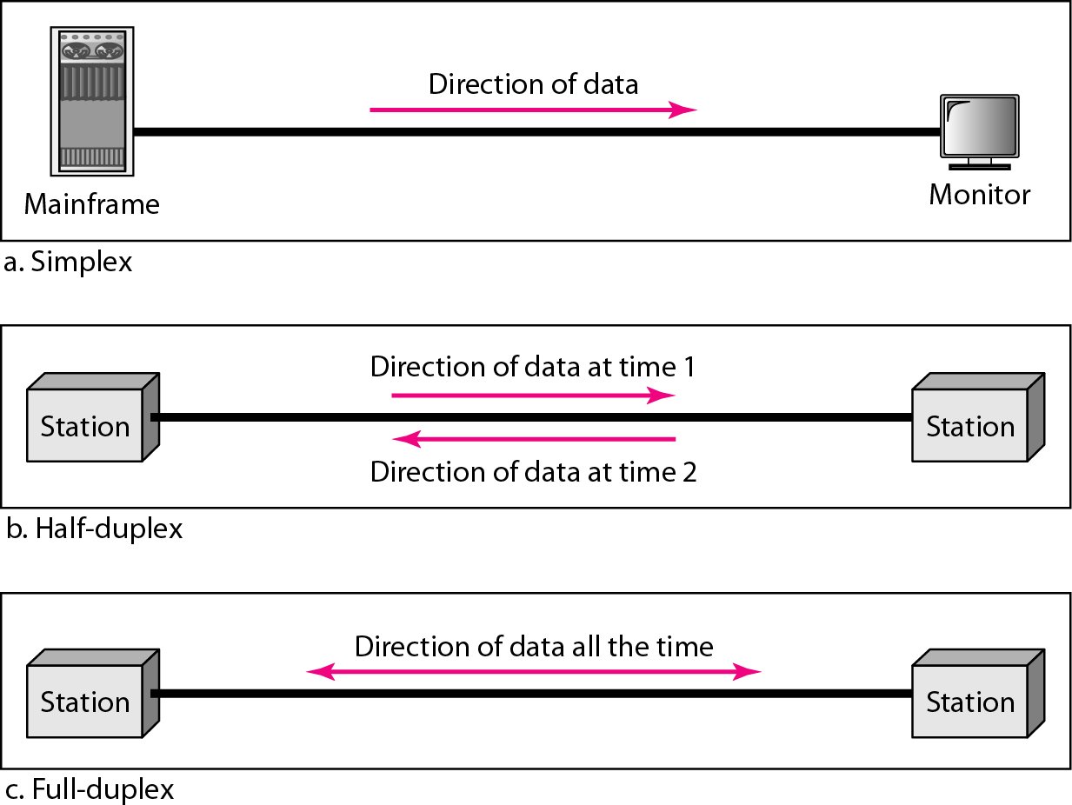
What are types of data communication ?
The data communication are three types based on the direction of exchange of information:
Simplex.
Half-Duplex.
Full Duplex.

Slide 28
Difference between Bandwidth and Data Rate.
Bandwidth: - It is defined as the width of the spectrum. Network bandwidth is used to measure the data transfer rate or capacity of a given network.
Question:- A given signal has frequencies of 3125 MHz, 635 MHz, 2000MHz and 7000Mhz. Determine the bandwidth of the signal?
Answer: - The bandwidth of a signal is the difference between the highest and the lowest frequencies. For the given system the bandwidth is 7000 – 635 = 6365MHz. Therefore the bandwidth of the signal is 6365MHz.
Data Rate: - Data Rate is defined as the amount of data transmitted during a specified time period over a network. It is the speed at which data is transferred from one device to another or between a peripheral device and the computer.
Data Rate: Data Rate is defined as the amount of data transmitted during a specified time period over a network. It is the speed at which data is transferred from one device to another or between a peripheral device and

Slide 29

Thanks

